Slide 1
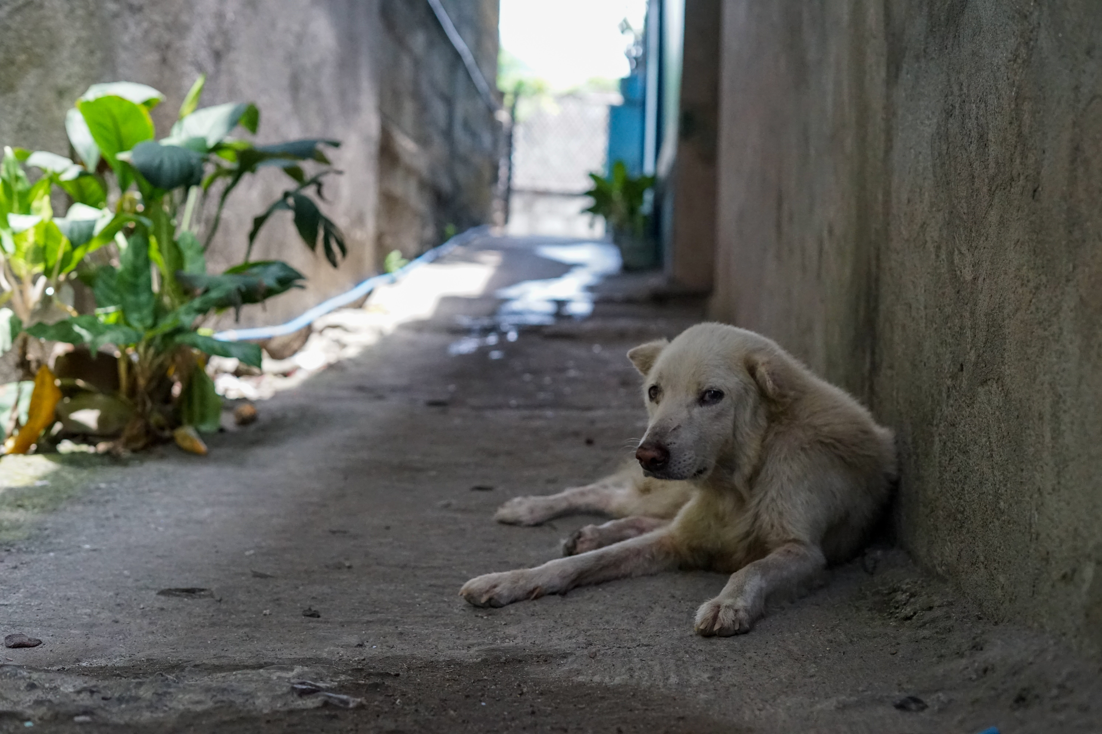

A REPORT TO OFFER ENGINEERING SOLUTIONS TO ELIMINATE THE HUNGER PROBLEM OF STRAY DOGS IN ERDEK UMUT STREET
Ömer Oktay Gültekin 21901413
Department of Computer Engineering
ENG 401-12
Figure 1: A Stray Dog Picture [1]
1

Slide 2
TABLE OF CONTENTS
01
Introduction
02
Problem Definition
03
Proposed Solutions
04
Criteria for Assessing Proposed Solutions
05
Proposed Research Methodology
06
Results and Analysis
07
Conclusion and Recommendations
08
References
2

Slide 3

1. Introduction
PETS
20%
STRAY DOGS
22%
OTHER FREE RANGE DOGS
58%
WORLD-WIDE TOTAL DOG POPULATION
900 Million
Figure 2: Distribution of the Worldwide Dog Population by Categories in 2018 [2]
3

Slide 4
1. Introduction
The country with the largest dog population in the world is in America:
Dogs: 77 Million [3]
Total Number of
Stray Animals: 70 Million [3]
3.3 million dogs enter a shelter,
Each Year [3]
2 million dogs get adopted from shelter,
670.000 dogs entering a shelter are euthanized,
4

Slide 5
1. Introduction
Turkey has approximately 10 million stray dogs, but only 250 shelters [4].
With urbanization, it has become difficult for dogs to find food, and with the food leftovers being thrown into the garbage at a height that dogs cannot reach, dogs have become dependent on humans for food [5].
Dogs can usually live without food three to five days if there is plenty of water [6].
Dogs can live a healthy life by eating every 24 hours [7].
The stable feeding system needed for the stray dogs.
5

Slide 6
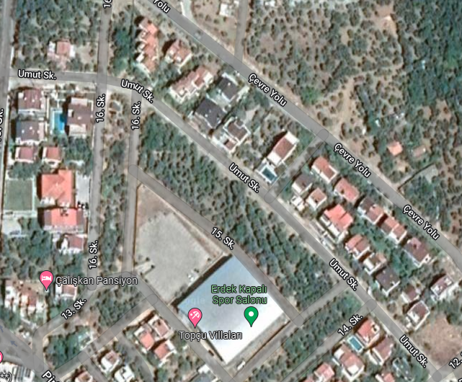

1. Introduction
The population of Erdek in winter is 32.038 [8].
The population of Erdek increases approximately 10 times during the summer months [9].
The majority of the Umut Street consist of those who come in the summer.
Ten dogs live in the Street [27].
Figure 3: Erdek Umut Street in Google Maps [10]
6

Slide 7



1. Introduction
Purpose: Establish a regular feeding system for stray dogs.
Impact: Prevent stray dogs from starving to death by ensuring they are fed regularly.
Significance: Becoming an example of shifting the responsibility of feeding street dogs from shelters to citizens to prevent the death of undernourished dogs.
7

Slide 8
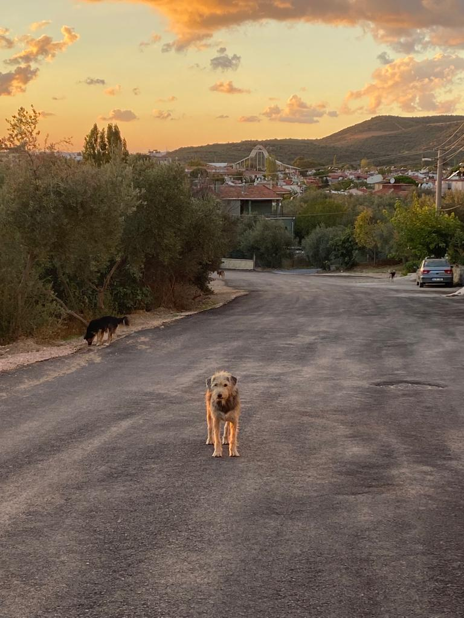
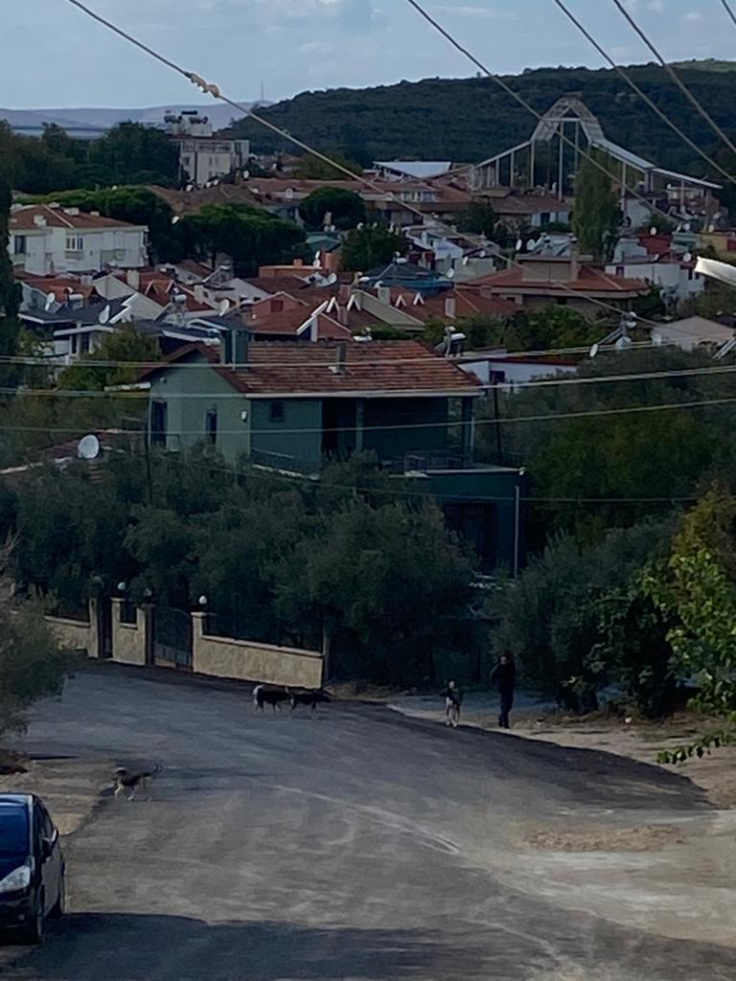
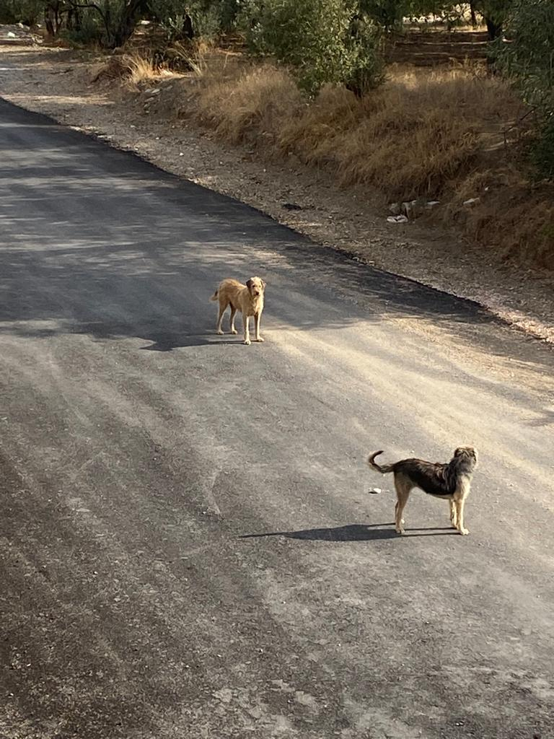
2. Problem Definition
Problem: The stray dogs in Erdek Umut Street cannot be fed regularly.
Figure 4: The Dogs Looking for Food [25]
Figure 5: A Volunteer is Giving Food to the Dogs [25]
Figure 6: The Photo of Stray Dogs [25]
8

Slide 9
2. Problem Definition
Who
Stray Dogs
What
Irregular Feeding of The Dogs
When:
Always but Especially in Winter
Where:
Erdek Umut Street
Why:
Lack of Coordination amongs the people
How:
Stray Dogs are not properly feeded
9

Slide 10
2. Problem Definition
Root Cause: Lack of Coordination Amongs the People
Lack of knowledge of whether the dogs were feeded.
Lack of containers of food and water for the animals in the street.
Very few people living in the street during the winter months.
10

Slide 11
3. Proposed Solutions
Proposed Solution 1
Designing RFID tag system to track feeding times of the dogs.
Proposed Solution 2
Designing Bluetooth based system to track feeding times of the dogs.
Proposed Solution 3
A smart feeding machine
11

Slide 12
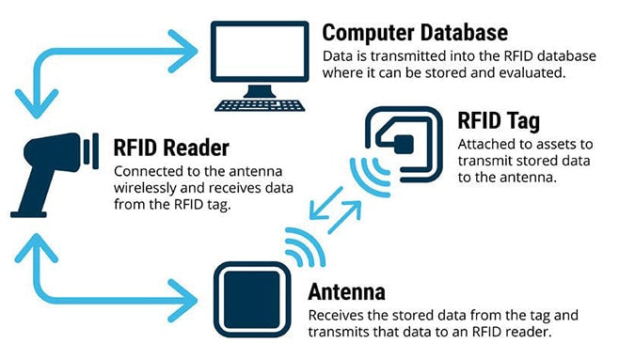
3.1 Proposed Solution 1: RFID Tag System
What is RFID?
Figure 7: RFID Tracking Down Process [11]
12

Slide 13
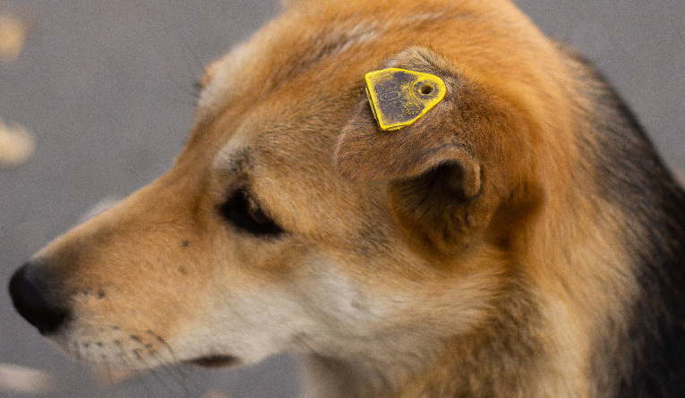

3.1 Proposed Solution 1: RFID Tag System
How is it work?
Figure 8: Dog Ear Tag [12]
Figure 9: RFID Tag Small Enough to Fit in Dog Ear Tag [13]
13

Slide 14
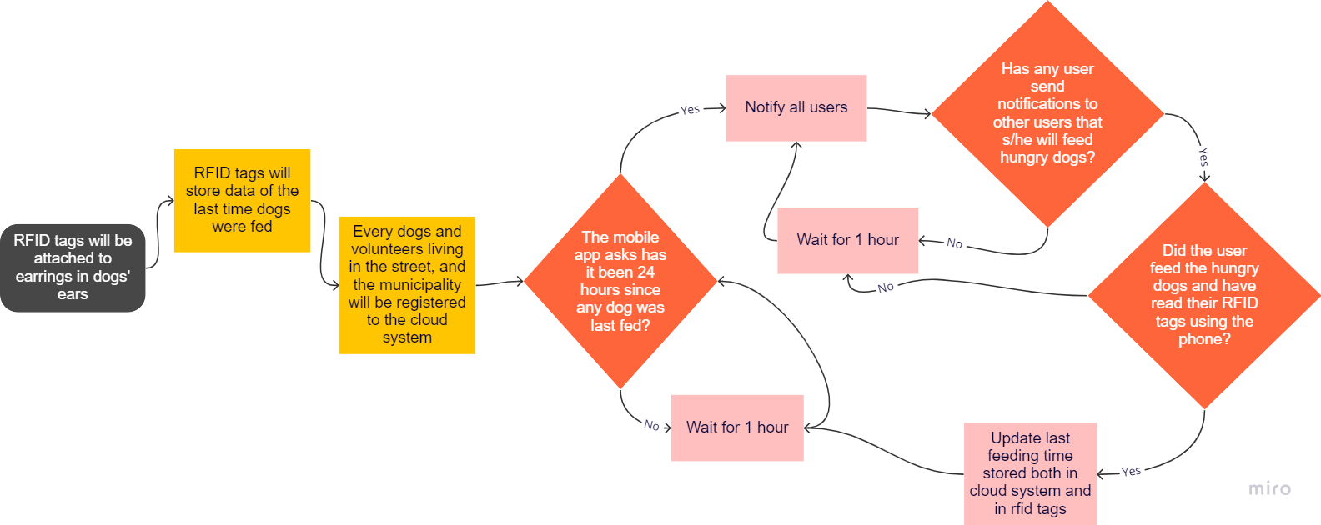
3.1 Proposed Solution 1: RFID Tag System
How is it work?
Figure 10: A Flow Diagram of RFID Tag System
14

Slide 15
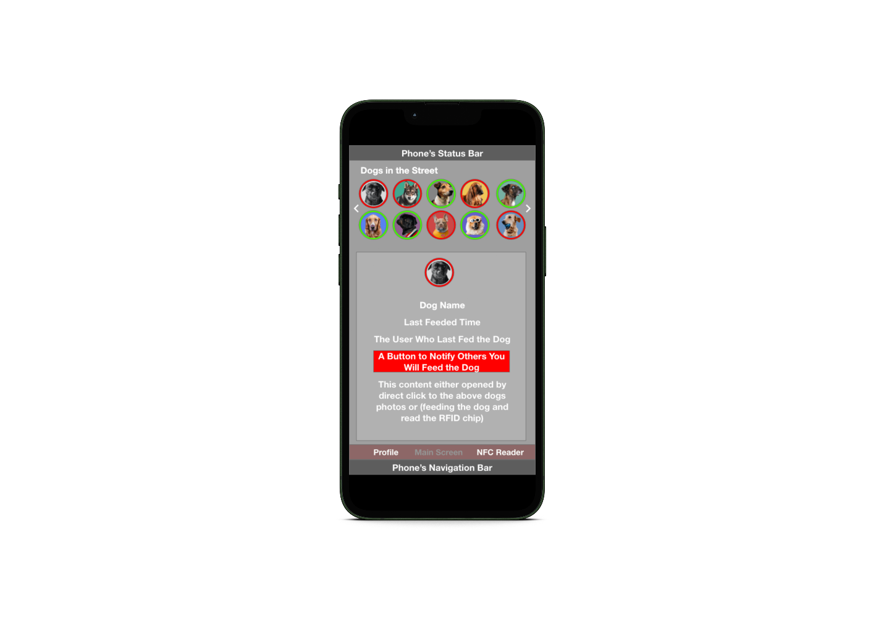


3.1 Proposed Solution 1: RFID Tag System
15
Figure 11: A Basic UI of The Mobile Application
Figure 12: Notification Templates of the App

Slide 16
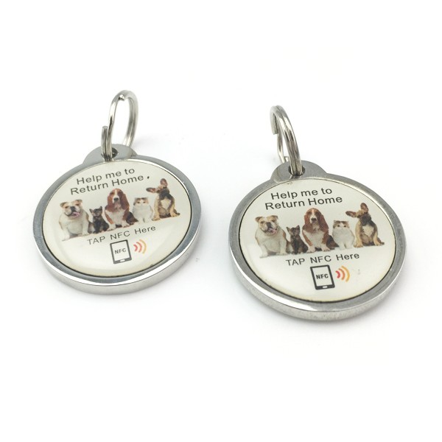
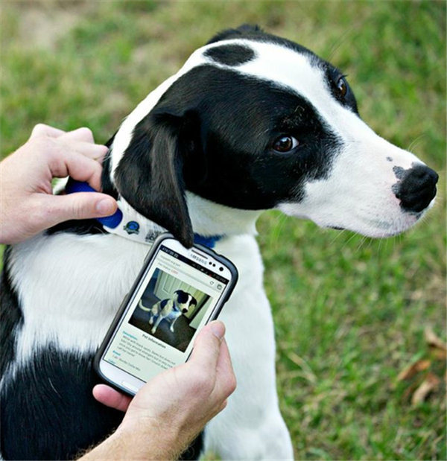
3.1 Proposed Solution 1: RFID Tag System
Similar Products:
Figure 13: Pet ID Tag [14]
Figure 14: Example Usage of ID Tag [14]
16

Slide 17
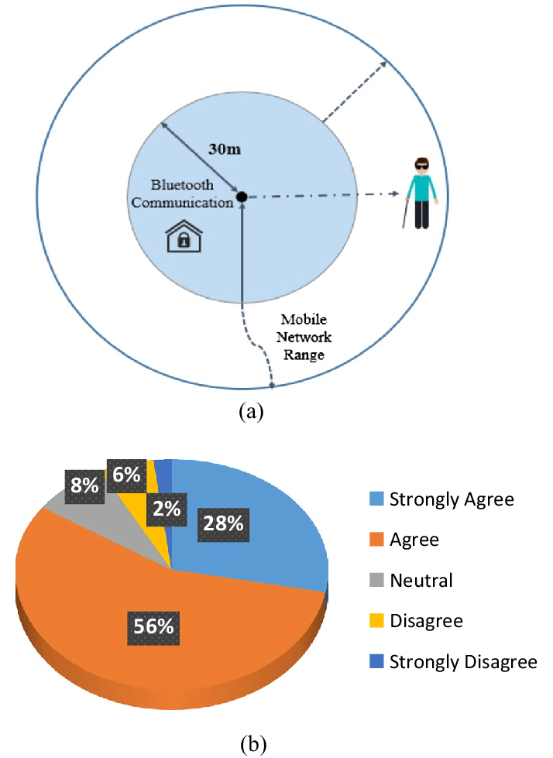
3.2 Proposed Solution 2: Bluetooth System
Advantages of Bluetooth:
Figure 15: Bluetooth Communication Range [15]
17

Slide 18
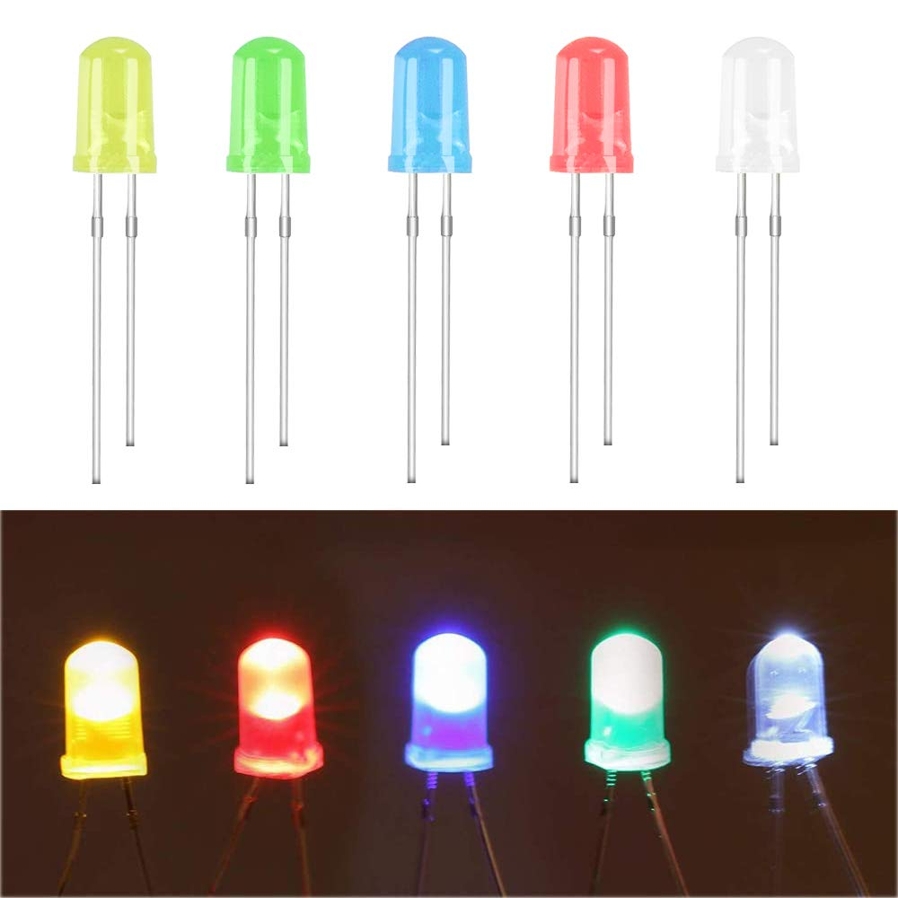
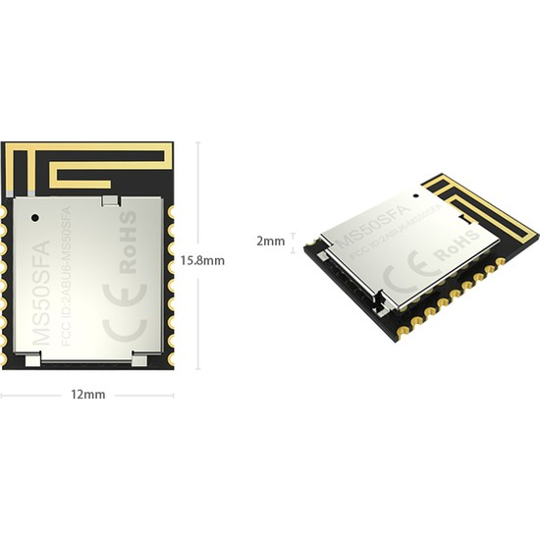
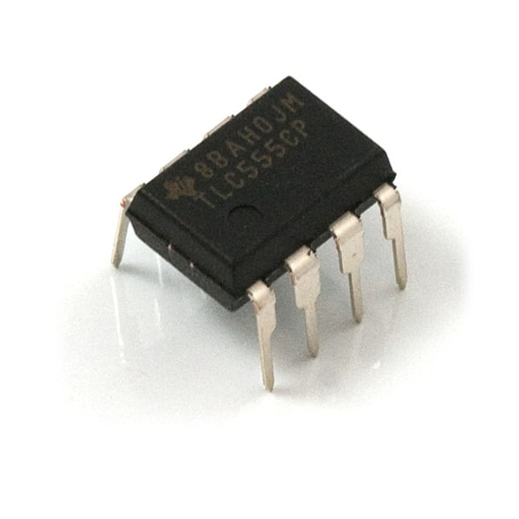
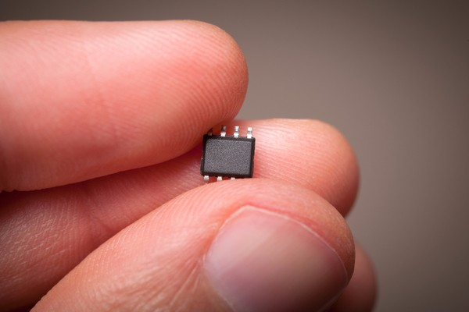
3.2 Proposed Solution 2: Bluetooth System
How is it work?
Figure 16: The NRF52832 Bluetooth Module [16]
Figure 17: An Example Microchip [17]
Figure 18: Example Led Component [18]
Figure 19: Example Timer Component [19]
18

Slide 19
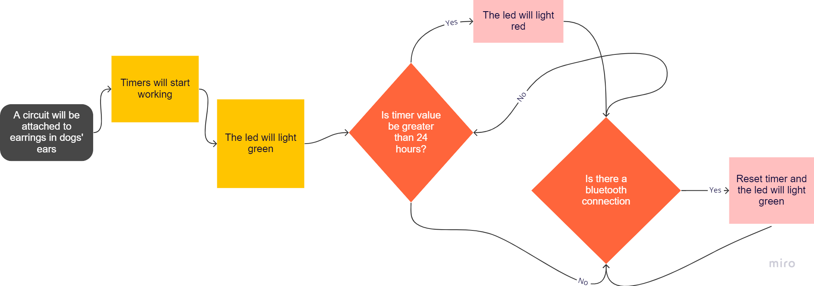
3.2 Proposed Solution 2: Bluetooth System
How is it work?
Figure 20: A Flow Diagram of Bluetooth System
19

Slide 20
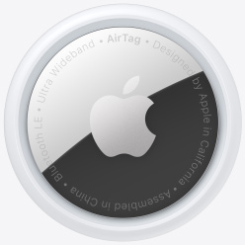
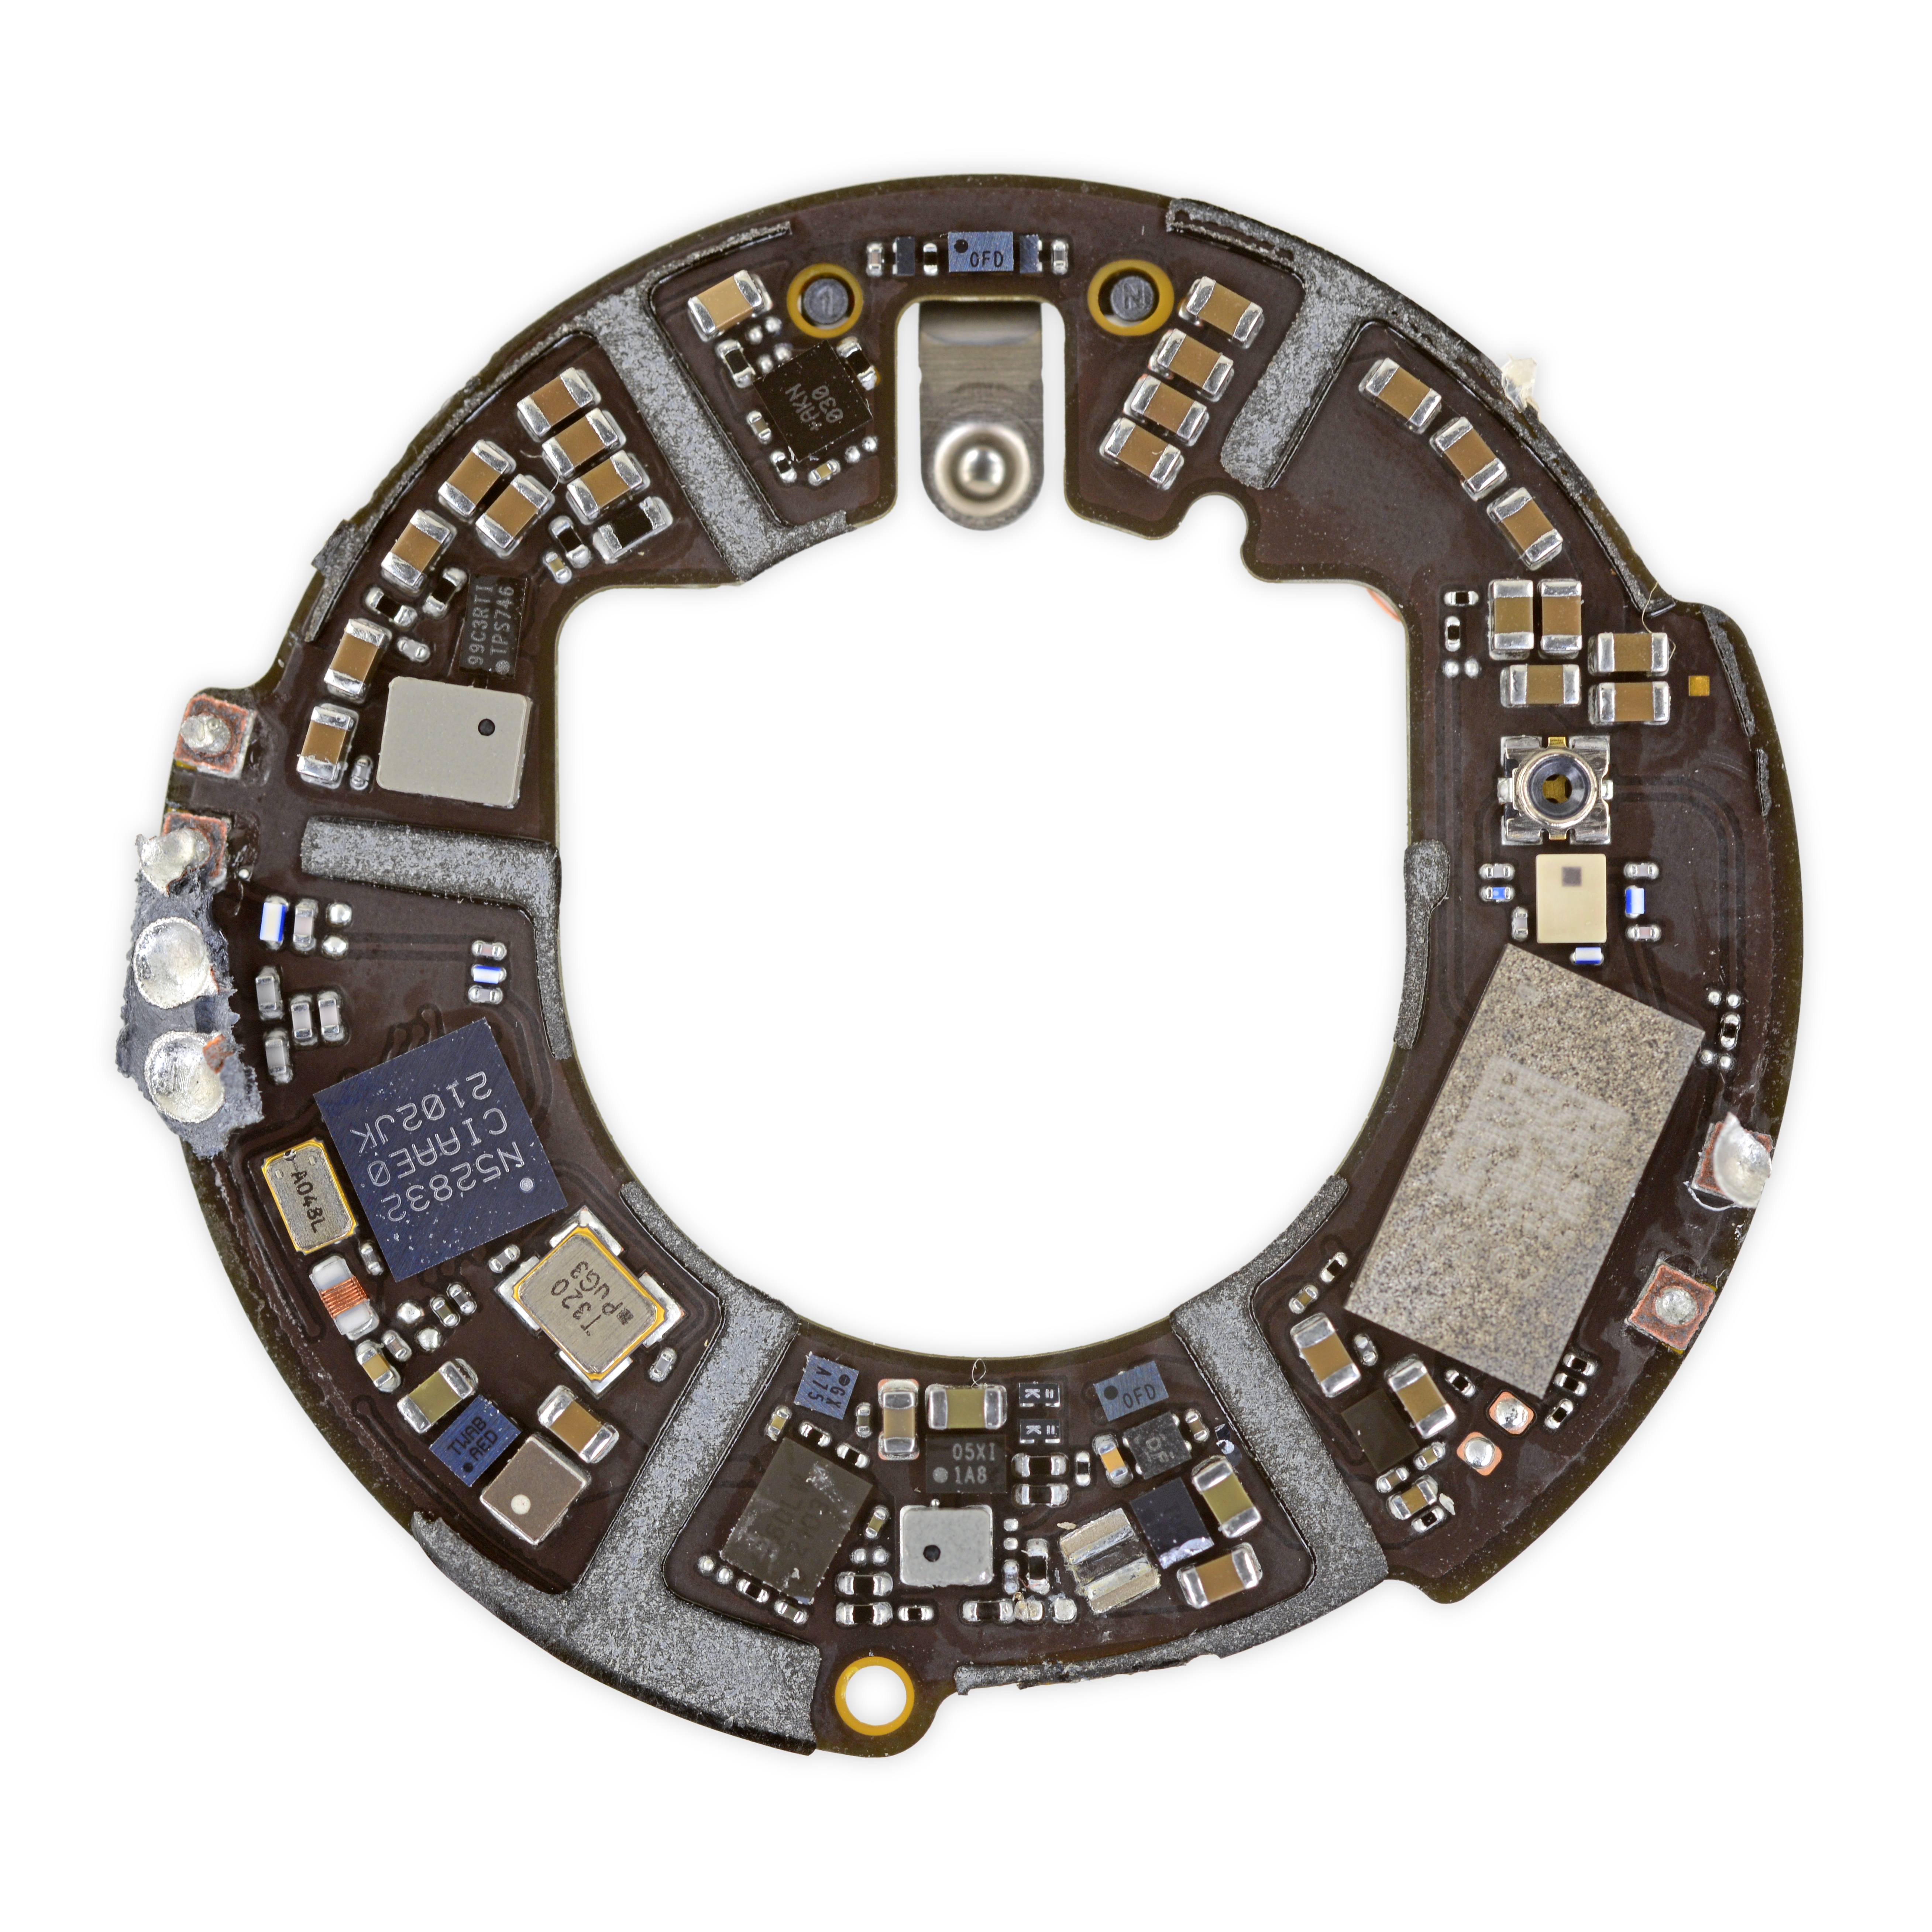
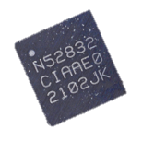
3.2 Proposed Solution 2: Bluetooth System
Similar Products:
Figure 21: Apple Airtag [20]
Figure 22: Inside of Apple Airtag [21]
20

Slide 21
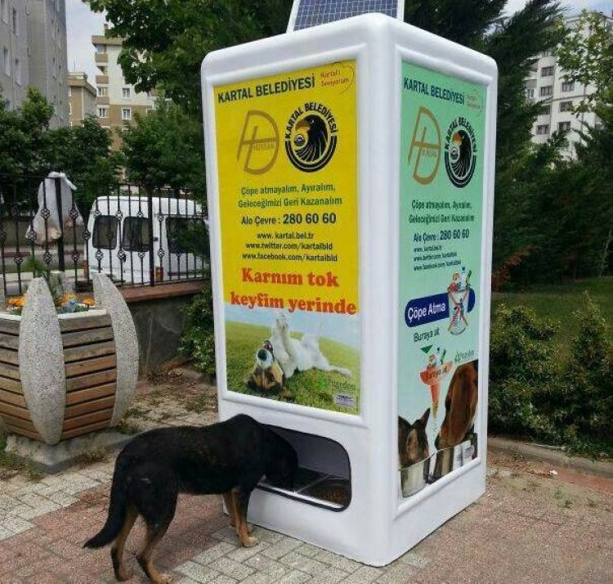
3.3 Proposed Solution 3: Smart Feeding System
Similar Products:
Figure 23: Sample Feeding Machine [22]
21

Slide 22
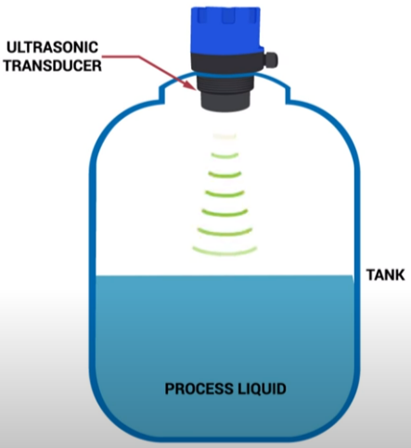
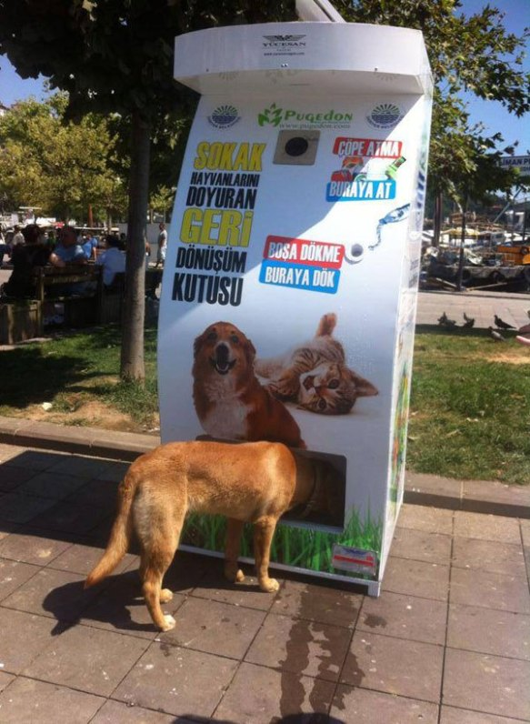

3.3 Proposed Solution 3: Smart Feeding System
How is it work?
Figure 24: A System to Measure the Food or Water Amount [23]
Figure 25: Feeding System [24]
Figure 26: Erdek Umut Street in Google Maps [10]
22

Slide 23
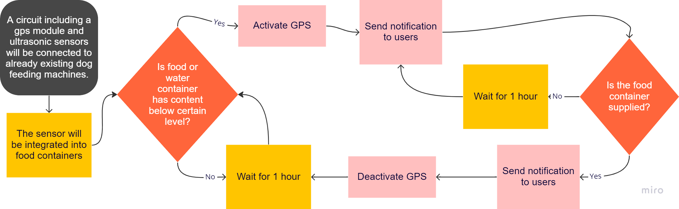
3.3 Proposed Solution 3: Smart Feeding System
How is it work?
Figure 27: A Flow Diagram of Smart Feeding System
23

Slide 24
4. Criteria for Assessing Proposed Solutions
4.1 Cost
All systems is compared based on total costs for all dogs.
RFID Tag System
Costs of:
RFID Tags
Shipment
App Development
Server
Municipality employee (Based on hourly work)
are calculated.
24

Slide 25
4. Criteria for Assessing Proposed Solutions
Bluetooth System
Costs of:
Implementation
Shipment
Coding
Replacement of dogs’ ear tags
Municipality employee (Based on hourly work)
are calculated.
25

Slide 26
4. Criteria for Assessing Proposed Solutions
Smart Feeding System
Costs of:
Implementation of the circuit
Coding
Feeding Machine
Shipments
Municipality employee (Based on hourly work)
are calculated.
26

Slide 27
4. Criteria for Assessing Proposed Solutions
Practicality: Each solution is questioned based on the practicality of the system (i.e easy to use, needs technical equipment, automates the process, etc.).
Sustainability: All systems are compared based on how many years can the solution be used.
27

Slide 28



5. Proposed Research Methodology
Market Research
Expert Opinion
Survey
28

Slide 29
5. Proposed Research Methodology
Market Research
This methodology is used for comparing the costs.
Survey
A survey is conducted with the municipality and volunteers for comparing the practicality of the solutions.
29

Slide 30
5. Proposed Research Methodology
Expert Opinion
Hardware vendors and verified experts on the internet are consulted to construct the real optimal implementation of the solutions.
Hardware vendors is consulted to understand technical capabilities of hardware to assess the sustainability of each solutions.
Mobile app developers on the internet is consulted for the implementation details of the necessary app the first solution needs.
30

Slide 31
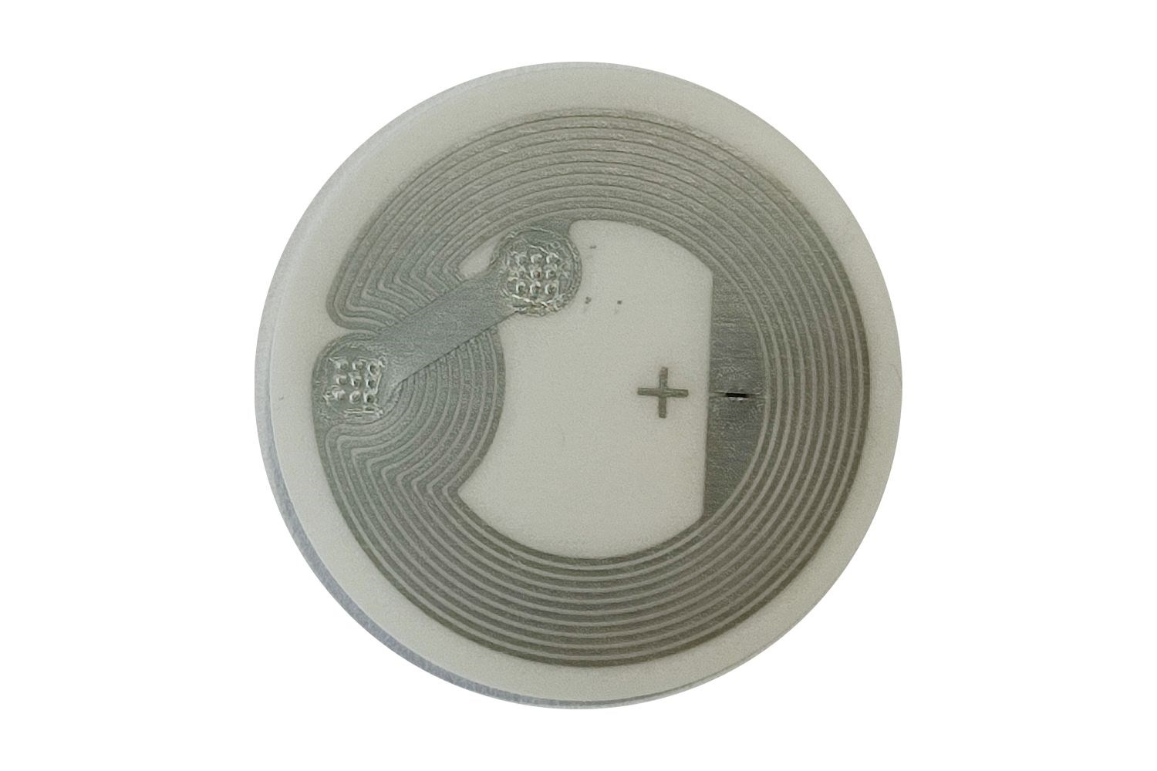
6. Results And Analysis
6.1.1: Implementation Details of the RFID Tag System
Firebase Database will be used [29].
Two separate apps are needed [29].
Android App will be written in Java using Android NFC Library [29] [30].
IOS App will be written in Swift using NFC Core Library [29] [31].
Figure 28: NFC Tag that will be used in implementation [28] [29]
31

Slide 32
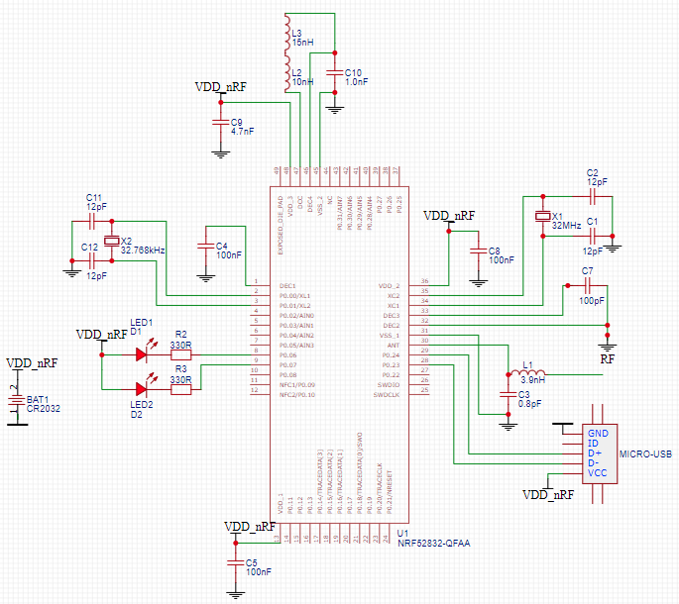
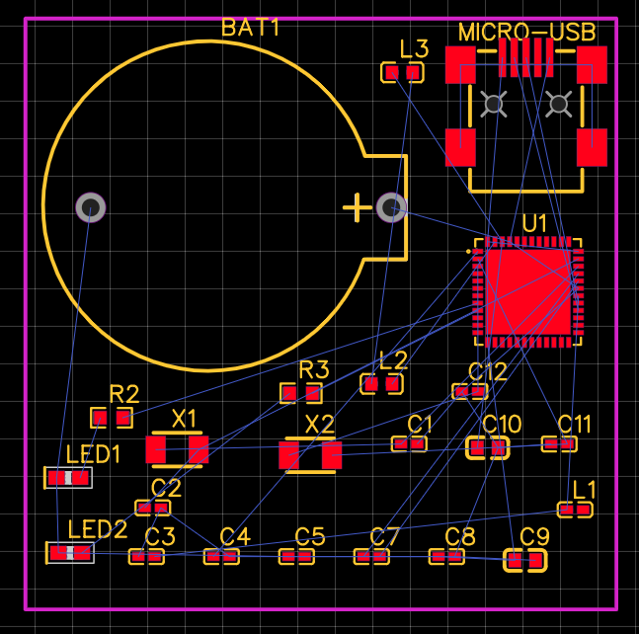
6. Results And Analysis
6.1.2: Implementation Details of the Bluetooth System
Figure 29: Schematic of the Bluetooth System
Figure 30: PCB Design of the Bluetooth System
32

Slide 33
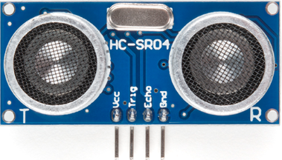
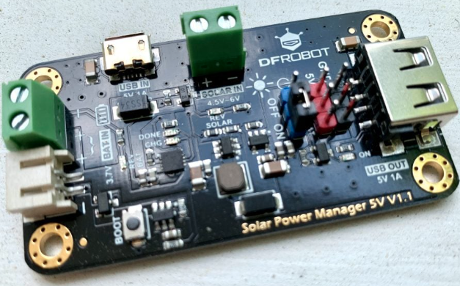
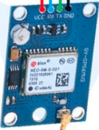
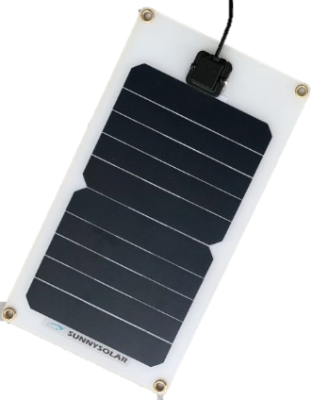
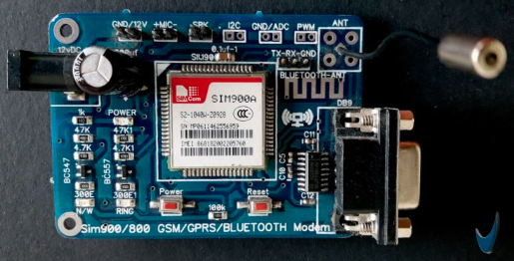

6. Results And Analysis
6.1.3: Implementation Details of the Smart Feeding System
Figure 32: Feeding System [24]
Figure 31: The main components of the
Hardware of the Smart Feeding System [32] [33] [34] [35]
33

Slide 34
6. Results And Analysis
6.2 Analysis
Figure 33: Assigned weights of the criterias
34

Slide 35
6. Results And Analysis
6.2.1 Cost Analysis
The least important criteria with weight 0.15.
Erdek Municipality has an 80 Million TL Budget; Money is not much important [36].
At most, $3000 can be allocated for each Street if the system’s maintenance cost is low[36].
There is already 2 personnel for feeding stray animals in the streets that have food containers [36].
These personnel needs to check the containers in case they are empty [36]. (Appr. 30 minutes per street) [58].
Figure 34: Cost Criteria Ratings for 1 year expenses
35

Slide 36
6. Results And Analysis
6.2.1.1 RFID Tag System Cost Analysis
Expenses | One-Time Cost | 1 Year Add. Cost (No Inflation) | Total Cost | Comments
RFGATE RFWL-D28 NFC Tag (Free Shipping) | $0.77 [28] | - | $0.77 * 10 = $7.7 | Data can be overriden 10.000 times [13].
Firebase Hosting | - | - | $0 | Free up to 10 GB storage [37].
IOS App Dev. | $210 [38] | - | $210
Android App Dev. | $104 [39] | - | $104
Expected Cost of Municipality Personnel (hourly work) | - | $290 [36] | $290 | Calculated assuming 1 hour of work per day.
Total Cost:
$611.7
Point: 3
36
Figure 35: Cost Analysis of RFID Tag System

Slide 37
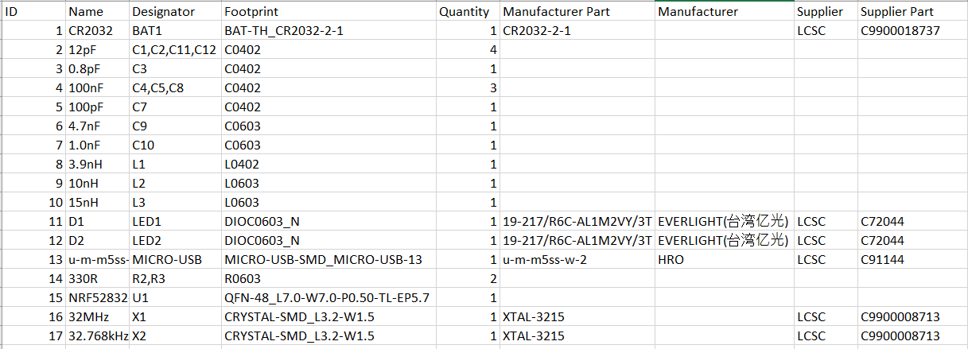
6. Results And Analysis
6.2.1.2 Bluetooth System Cost Analysis
Figure 36: BOM file of the Bluetooth Integrated Circuit
37

Slide 38
6. Results And Analysis
6.2.1.2 Bluetooth System Cost Analysis
PCB Price
Confirm Production file $0.50
Production $5
SMT Price
Setup fee $25.00
Stencil $7.86
Components $37.69
Feeders Loading fee $18.90
SMT Assembly $1.83
Confirm Parts Placement $0.43
Hand-soldering labor fee $3.50
Manual Assembly $0.47
Packaging fee $0.47
Shipping $69.09
Total $170.74
Cost of Coding NRF52:
$105 (One Time) [40]
Expected Cost of Municipality Personnel (hourly work):
$8 (One Time) [36]
$290 (1 Year) [36]
Cost of New Ear Tags:
$2 (One Time) [42]
(Assuming the circuit will not break.)
Total $405
Total Cost:
$575.74
Point: 3
38
Figure 37: One Time Cost of 10 Circuit [41]
Figure 38: Other Costs

Slide 39
6. Results And Analysis
6.2.1.3 Smart Feeding System Cost Analysis
Ardunio Price:
$25 * 2 = $50 (One Time) [44]
Ultrasonic Distance Sensor:
$4.50 * 4 = $18 (One Time) [50]
Sim Module:
$11 * 2 = $22 (One Time) [49]
Solar Power Manager with Panel:
$25.40 * 2 = $50.80 (One Time) [48]
Gps Module:
$6 * 2 = $12 (One Time) [47]
Additional Components (Wires Breadboard etc.)
$10 [51]
Total $162.80
Cost of Coding Ardunio:
$157 (One Time) [43]
Expected Cost of Municipality Personnel (hourly work):
-$145 (1 Year) [36]
Replaced Battery Cost:
$8 * 1 * 2 = $16 (1 Year) [46] [55]
Machine Cost:
$1000 * 2 = $2000 (One Time) [45]
Expected shipment cost:
$10
Total $2038
Total Cost:
$2290.8
Point: 1
39
Figure 39: One Time Cost of 2 Circuit [41]
Figure 40: Other Costs

Slide 40
6. Results And Analysis
6.2.2 Sustainability Analysis
Is the solution waterproof?
Can the solution work in extreme temperatures?
Does the solution needs replacements?
Is the solution durable to physical contact?
Can this solution be used for a long time?
The 2nd important criterion with a weight, 0.30.
The solutions must be durable since they cannot be changed easily.
4 possible answers (No, Major Drawback, Minor Drawback, Yes)
Questions answered using data sheets from hardware vendors.
3 points per question.
Figure 41: Sustainability Criteria
40

Slide 41
6. Results And Analysis
6.2.2.1 RFID Tag System Sustainability Analysis
Is the solution water-proof?
Can the solution work in extreme temperatures?
Does the solution needs replacements?
Is the solution durable to physical contact?
Can this solution be used for a long time?
2 (Water-proof but antenna cannot work in wet conditions) [52]
3 (The solution works between temperatures -20℃ and 70℃) [28]
3 (The solution Works without replacement for 10 years) [13]
3 (There are already RFID tags at dog’s ears)
3 (10 year) [13]
Total Point:
14
41

Slide 42
6. Results And Analysis
6.2.2.2 Bluetooth System Sustainability Analysis
Is the solution water-proof?
Can the solution work in extreme temperatures?
Does the solution needs replacements?
Is the solution durable to physical contact?
Can this solution be used for a long time?
0 [53]
3 (The solution works between temperatures -40℃ and 125℃) [53]
2 (Batteries needs replacement every 1 year) [54]
1 (Weight of the circuit is 342.51 gr and circuit can be damaged) [41]
1 (Dogs will probably tear it) [36]
Total Point:
7
42

Slide 43
6. Results And Analysis
6.2.2.3 Smart Feeding System Sustainability Analysis
Is the solution water-proof?
Can the solution work in extreme temperatures?
Does the solution needs replacements?
Is the solution durable to physical contact?
Can this solution be used for a long time?
3 (Machine protects the circuit)
3 (Machine protects the circuit)
2 (Battery can only tolerate 7 subsequent rainy day) [56]
3 (Machine protects the circuit)
3 (Circuit can works for decades) [57]
Total Point:
14
43

Slide 44
6. Results And Analysis
6.2.3 Practicality Analysis
Questions | Yes | No
Are you comfortable in close contact with the dogs while feeding?
Do you have a smartphone or iPhone with IOS > 14.0 ?
Do you have a phone with SMS functionality?
Are you comfortable with allocating 5 minutes of time after every feeding?
Can you see a led with appr. 1cm diameter from 10m distance?
Do you prefer feeding dogs by using a central or local container?
Is a system to see the feeding status of the dogs usable?
Figure 42: Practicality Problem Analysis Survey with Residents and Municipality Personnel
44

Slide 45
6. Results And Analysis
6.2.3 Practicality Analysis
Is the solution easy to use?
Is the solution automated the process?
Does the solution not need contact with the dogs?
Does volunteers and municipality personnel have the necessary technical equipment?
On the long rung, how likely will the solution be used?
The most important criteria with a weight, 0.55.
The solutions must be practical so that the feeding of the dogs should be systematic and easy.
4 possible answers (No, Major drawback or at least 30% state it is a problem, Minor drawback or at most 30% state it is a problem, Yes).
The most important criteria for practicality were detected by conducting a survey with street residents (only 20% of them) and talking to municipality personnel.
Questions were answered by additional short surveys where needed.
Figure 43: Practicality Criteria
45

Slide 46
6. Results And Analysis
6.2.3.1 RFID System Practicality Analysis
Is the solution easy to use?
Is the solution automated the process?
Does the solution not need contact with the dogs?
Does volunteers and municipality personnel have the necessary technical equipment?
On the long rung, how likely will the solution be used?
1 (40% do not find the solution easy)
1 (Manual process to read tags)
1 (Needed distance is appr. 30 cm) [28]
2 (10% either have not a smartphone or use IOS <14.0)
1 (60% find it tedious)
Total Point:
6
46

Slide 47
6. Results And Analysis
6.2.3.2 Bluetooth System Practicality Analysis
Is the solution easy to use?
Is the solution automated the process?
Does the solution not need contact with the dogs?
Does volunteers and municipality personnel have the necessary technical equipment?
On the long rung, how likely will the solution be used?
2 (20% do not find the solution easy to use)
1 (Manual process to connect Bluetooth)
2 (Needed distance is appr. 30m) [28]
2 (Municipality personnel won’t get notifications from a distance)
1 (the circuit is too heavy)
Total Point:
8
47

Slide 48
6. Results And Analysis
6.2.3.3 Smart Feeding System Practicality Analysis
Is the solution easy to use?
Is the solution automated the process?
Does the solution not need contact with the dogs?
Does volunteers and municipality personnel have the necessary technical equipment?
On the long rung, how likely will the solution be used?
3 (90% find the solution easy to use)
3 (Automatic detection – notification system)
3 (Feeding Machines)
3 (SMS)
3
Total Point:
15
48

Slide 49
7. Conclusions And Recommendations
 | CRITERIA
Solution | Cost | Sustainability | Practicality | Total
RFID Tag System | 3/5 * 0.15 | 14/15 * 0.3 | 6/15 * 0.55 | 0.59
Bluetooth System | 3/5 * 0.15 | 7/15 * 0.3 | 8/15 * 0.55 | 0.52
Smart Feeding System | 1/5 * 0.15 | 14/15 * 0.3 | 15/15 * 0.55 | 0.86
Figure 44: Evaluation of the results
49

Slide 50
7. Conclusions And Recommendations
Most optimal solution is Smart Feeding System.
Advantages:
Well-Tested Working Examples
Automation
Long Sustainability
Disadvantages:
High Cost
RFID Tag System is not optimal due to its high impracticality.
Bluetooth System is not optimal due to its high unsustainability (4cm-4cm dimensions, 342.51 gr weight).
50

Slide 51
7. Conclusions And Recommendations
Action Plan
Circuit components will be ordered.
Machines will be ordered from Pugedon Company.
Coding and testing of the circuits will be done.
Municipality will contact the street residents to save their phone numbers into the system.
Circuits will be integrated into the feeding machines.
1-week test with the Street residents will be conducted.
 | w1 | w2 | w3 | w4 | w5 | w6
1
2
3
4
5
6
Figure 45: Gantt chart of the action plan
51

Slide 52
8. References
[1] A. Young, White Dog Lying Beside Wall. 2019 [Online].
Available: https://unsplash.com/photos/pCJCfl5HWdA. [Accessed: 14- Oct- 2022].
[2] N. Cosgrove, "How Many Dogs Are There? (US & Worldwide Statistics 2022) | Pet Keen", Pet Keen, 2022. [Online]. Available: https://petkeen.com/how-many-dogs-are-there-statistics/.
[Accessed: 14- Oct- 2022].
[3] "How Many Pets Are In The World & The US? 71+ Pet Stats", Simply Insurance™, 2022.
[Online]. Available: https://www.simplyinsurance.com/pet-statistics/. [Accessed: 14- Oct- 2022]
[4] "4 Nisan Sokak Hayvanları Günü: Türkiye'de sokak hayvanları ne durumda ve neden tartışılıyor? –
BBC News Türkçe", BBC News Türkçe, 2022. [Online].
Available: https://www.bbc.com/turkce/haberler-turkiye-60947128. [Accessed: 14- Oct- 2022].
52

Slide 53
8. References
[5] "İçişleri Bakanlığı’ndan araştırma: ‘Sokak hayvanları tehlikeli mi?’ ‘Evet’ yüzde 34, ‘Hayır’ yüzde 45", Hurriyet.com.tr, 2022. [Online]. Available: https://www.hurriyet.com.tr/yazarlar/nedim-sener/icisleri-bakanligindan-arastirma-sokak-hayvanlari-tehlikeli-mi-evet-yuzde-34-hayir-yuzde-45-42029404. [Accessed: 14- Oct- 2022].
[6] "How to Get a Sick Dog to Eat", Drphillipsanimalhospital.com, 2022. [Online]. Available:
https://drphillipsanimalhospital.com/2020/08/31/how-to-get-a-sick-dog-to-eat/.
[Accessed: 14- Oct- 2022].
[7] "Feeding pet dogs just once a day might keep them healthier as they age", New Scientist, 2022. [Online]. Available: https://www.newscientist.com/article/2298623-feeding-pet-dogs-just-once-a-day-might-keep-them-healthier-as-they-age/. [Accessed: 14- Oct- 2022].
53

Slide 54
8. References
[8] "Balıkesir Erdek Nüfusu 2021 - 2022 | Erdek İlçesinin Yüzölçümü kaçtır?", Bölge Gündem Haber, 2022. [Online]. Available: https://www.bolgegundem.com/balikesir-erdek-nufusu-2020-2021-erdek-ilcesinin-yu zolcumu-kactir-1429462h.htm#:~:text=2021%20-%202022%20Balıkesir%20Erdek%20nüfusu, Bin%20038%20kişi%20olduğu%20açıklandı. [Accessed: 14- Oct- 2022].
[9] "Erdek sahilleri Akdeniz'i aratmıyor FOTO GALERİ", hthayat.haberturk.com, 2022. [Online]. Available: https://www.haberturk.com/ekonomi/turizm/haber/534319-erdek-sahilleri-akdenizi-aratmiyor-foto-galeri. [Accessed: 14- Oct- 2022].
[10] "Umut Sk., Erdek/Balıkesir", Google.com, 2022. [Online].
Available: https://www.google.com/maps/place/Umut+Sk.,+Erdek%2FBalıkesir/@40.4095282,27.7871197,17.75z/data=!4m5!3m4!1s0x14b42efc300f7295:0x4152942a854c004a!8m2!3d40.409539!4d27.788246. [Accessed: 14- Oct- 2022].
54

Slide 55
8. References
[11] "What Is RFID Technology and How Can I Use It?", Shopify, 2022. [Online]. Available: https://www.shopify.com/retail/rfid-technology. [Accessed: 14- Oct- 2022].
[12] "Marking Street Dogs – Parsemus Foundation", Parsemus Foundation, 2022. [Online]. Available: https://www.parsemus.org/pethealth/marking-street-dogs/. [Accessed: 14- Oct- 2022].
[13] "Buy 13.56Mhz NFC Sticker/Tag - ISO14443A, Ntag 213, 25mm with cheap price", https://www.robotistan.com/, 2022. [Online]. Available: https://www.robotistan.com/1356mhz-nfc-etiket-iso14443a-ntag-213-25mm. [Accessed: 14- Oct- 2022].
[14] "Smart Touch Nfc Ntag213/ntag216 Chip Unit Qr Code Finds Pet Id Tag Funny Collar Anti-lost Pet Epoxy Tag For Cat Dog - Buy Smart Touch Nfc Unit Qr Code Finds Pet Id Tag Funny Collar Anti-lost Pet Epoxy Tag For Cat Dog,Nfc Tag,Id Tag Product on Alibaba.com", Alibaba.com, 2022. [Online]. Available: https://www.alibaba.com/product-detail/Nfc-Chip-Tag-Nfc-Rfid-Tags_60841583620.html. [Accessed: 14- Oct- 2022].
55

Slide 56
8. References
[15] W. Rahman, R. Islam, M. Hasan and S. Mia, "IoT Based Smart Assistant for Blind Person and Smart Home Using the Bengali Language", Springer Nature, 2020 [Online]. Available: https://www.researchgate.net/publication/344219052_IoT_Based_Smart_Assistant_for_Blind_Person_and_Smart_Home_Using_the_Bengali_Language. [Accessed: 14- Oct- 2022].
[16] "Minew MS50SFA NRF52832 Low Energy 5.0 Bluetooth Modülü", hepsiburada, 2022. [Online]. Available: https://www.hepsiburada.com/minew-ms50sfa-nrf52832-low-energy-5-0-bluetooth-modulu-pm-HBC0000132PZD. [Accessed: 14- Oct- 2022].
[17] K. Levermore, "A brief history of the microchip - Dialogue Review", Dialogue Review, 2022. [Online]. Available: https://dialoguereview.com/brief-history-microchip/. [Accessed: 14- Oct- 2022].
[18] "(100 Pcs) MCIGICM 5mm LED Light Diodes, LED Circuit Assorted Kit for Science Project Experiment (Multi-Colored - 5 Color)", Amazon.com, 2022. [Online]. Available: https://www.amazon.com/MCIGICM-Circuit-Assorted-Science-Experiment/dp/B07PG84V17. [Accessed: 14- Oct- 2022].
56

Slide 57
8. References
[19] "555 Timer IC - DIP-8", Proto-PIC, 2022. [Online]. Available: https://proto-pic.co.uk/product/555-timer-ic. [Accessed: 14- Oct- 2022].
[20] "AirTag", Apple (Türkiye), 2022. [Online]. Available: https://www.apple.com/tr/airtag/. [Accessed: 14- Oct- 2022].
[21] "AirTag Teardown: Yeah, This Tracks", IFIXIT, 2022. [Online]. Available: https://www.ifixit.com/News/50145/airtag-teardown-part-one-yeah-this-tracks. [Accessed: 14- Oct- 2022].
[22] "Vending Machine for Stray Dogs", The Bark, 2022. [Online]. Available: https://thebark.com/content/vending-machine-stray-dogs. [Accessed: 14- Oct- 2022].
[23] OMEGA Engineering, Water Level Sensor Types and how they work!. 2022 [Online]. Available: https://www.youtube.com/watch?v=bHxEXlIHSHY. [Accessed: 14- Oct- 2022].
57

Slide 58
8. References
[24] "machine feeding strays – Fascinating Animals", Fascinating Animals, 2022. [Online]. Available: https://facinatingamazinganimals.wordpress.com/tag/machine-feeding-strays/. [Accessed: 14- Oct- 2022].
[25] E. Gültekin, A Stray Dog. 2022.
[26] Elevated view of straight and curve road in forest. 2022 [Online]. Available: https://www.freepik.com/free-photo/elevated-view-straight-curve-road-forest_2579789.htm#query=top%20view%20road%20forest&position=3&from_view=keyword. [Accessed: 14- Oct- 2022].
[27] H. Cihan, private communication, November 2022.
[28] “RFGATE RFWL-D28 NFC etiket,” RFIDmarket. [Online]. Available: https://www.rfidmarket.com.tr/rfgate-rfwl-d28-nfc-etiket. [Accessed: 07-Dec-2022].
[29] A. Demircan, private communication, November 2022.
58

Slide 59
8. References
[30] “Advanced NFC overview : android developers,” Android Developers. [Online]. Available: https://developer.android.com/guide/topics/connectivity/nfc/advanced-nfc. [Accessed: 07-Dec-2022].
[31] “Creating NFC Tags from Your iPhone,” Apple Developer Documentation. [Online]. Available: https://developer.apple.com/documentation/corenfc/creating_nfc_tags_from_your_iphone. [Accessed: 07-Dec-2022].
[32] “Arduino Uno REV3,” Arduino Official Store. [Online]. Available: https://store.arduino.cc/products/arduino-uno-rev3/. [Accessed: 07-Dec-2022].
[33] “Ultrasonic distance sensor - HC-SR04,” SEN-15569 - SparkFun Electronics. [Online]. Available: https://www.sparkfun.com/products/15569. [Accessed: 07-Dec-2022].
[34] A. Beale, “3 ways to solar power an Arduino (step by step!),” Footprint Hero, 20-May-2022. [Online]. Available: https://footprinthero.com/how-to-solar-power-an-arduino. [Accessed: 07-Dec-2022].
[35] “How to send GPS location via SMS using GSM and Arduino? - mechatrofice.” [Online]. Available: https://mechatrofice.com/arduino/send-gps-location-via-sms. [Accessed: 07-Dec-2022].
59

Slide 60
8. References
[36] M. Sezer, private communication, December 2022.
[37] “Firebase pricing,” Google. [Online]. Available: https://firebase.google.com/pricing. [Accessed: 07-Dec-2022].
[38] “I will make ios app from scratch in swift, objective c or in swiftui by BNP1711 Fiverr,” fiverr. [Online]. Available: www.fiverr.com/bnp1711/make-ios-app-from-scratch-in-swift-or-objective-c. [Accessed: 07-Dec-2022].
[39] “I will your android app developer from scratch by mouzamali724 Fiverr,” fiverr. [Online]. Available: https://www.fiverr.com/mouzamali724/your-android-app-developer-or-develop-android-app-from-starch. [Accessed: 09-Dec-2022].
[40] “Develop firmware for microcontrollers NRF52 Arduino ESP32 by Hassam_arshad | Fiverr,” fiverr. [Online]. Available: https://www.fiverr.com/hassam_arshad/bluetooth-ble-project-using-nordic-controllers. [Accessed: 09-Dec-2022].
[41] “LCSC - China's leading electronic components distributor,” www.lcsc.com. [Online]. Available: https://www.lcsc.com/. [Accessed: 09-Dec-2022].
60

Slide 61
8. References
[42] “Büyükbaş Küpesi (BB100),” Büyükbaş Hayvan Kulak Küpesi. [Online]. Available: https://www.ciftciyik.com/urun/buyukbas-kupesi-bb100. [Accessed: 09-Dec-2022] .
[43] “Do Arduino, ESP8266, ESP32 coding and programming by vortex968 | Fiverr,” fiverr [Online]. Available: https://www.fiverr.com/vortex968/write-code-for-you-micro-controller-projects. [Accessed: 09-Dec-2022].
[44] “Arduino Uno REV3,” Arduino Official Store. [Online]. Available: https://store.arduino.cc/products/arduino-uno-rev3/. [Accessed: 09-Dec-2022].
[45] K. Ayanoğlu, private communication, December 2022.
[46] “Buy 3,7v lipo battery 950MAH 30C - mbot battery with cheap price,” https://www.robotistan.com/. [Online]. Available: https://www.robotistan.com/37v-lipo-batarya-950mah-30c-mbot-pili. [Accessed: 09-Dec-2022].
61

Slide 62
8. References
[47] “Buy gy-NEO6MV2 GPS module for flight controller systems with cheap price,” https://www.robotistan.com/. [Online]. Available: https://www.robotistan.com/gy-neo6mv2-gps-modulu-ucus-kontrol-sistem-gpsi. [Accessed: 09-Dec-2022].
[48] “Solar Power manager with panel (5V 1A),” DFRobot. [Online]. Available: https://www.dfrobot.com/product-2000.html. [Accessed: 09-Dec-2022].
[49] “Buy SIM800L GPRS module - affordable price,” https://www.robotistan.com/. [Online]. Available: https://www.robotistan.com/sim800l-gprs-modulu. [Accessed: 09-Dec-2022].
[50] “Ultrasonic distance sensor - HC-SR04,” SEN-15569 - SparkFun Electronics. [Online]. Available: https://www.sparkfun.com/products/15569. [Accessed: 09-Dec-2022].
[51] A. Industries, “New Products,” adafruit industries blog RSS. [Online]. Available: https://www.adafruit.com/. [Accessed: 09-Dec-2022].
62

Slide 63
8. References
[52] “Are RFID chips waterproof? - quora,” Quora. [Online]. Available: https://www.quora.com/Are-RFID-chips-waterproof. [Accessed: 09-Dec-2022].
[53] “NRF52 product specification - nordic semiconductor.” [Online]. Available: https://infocenter.nordicsemi.com/pdf/nRF52832_PS_v1.3.pdf. [Accessed: 09-Dec-2022].
[54] J. Clover, “AirTags: Apple's item trackers - everything we know,” MacRumors, 10-Nov-2022. [Online]. Available: https://www.macrumors.com/guide/airtags/. [Accessed: 09-Dec-2022].
[55] “Erdek'te 30 Günlük Hava Durumu - Erdek.Hava Durumu,” Yandex.Hava Durumu. [Online]. Available: https://yandex.com.tr/hava/erdek/month?via=cnav. [Accessed: 09-Dec-2022].
[56] “How long can an Arduino run on a battery? - quora,” Quora. [Online]. Available: https://www.quora.com/How-long-can-an-Arduino-run-on-a-battery. [Accessed: 09-Dec-2022].
[57] “How long can arduino stay on? - quora,” Quora. [Online]. Available: https://www.quora.com/How-long-can-Arduino-stay-on. [Accessed: 09-Dec-2022].
[58] S. Öztürk, private communication, December 2022.
63

Slide 64

THANKS
FOR
LISTENING!
Figure 23: A Representation of the Three Solution [26]
64

